Slide 1
A Survey for text represention
-----yang zhou

Slide 2
statistical language model
1) n-gram (no embedding)
Neural Network Language Model
1) according to the neural probabilistic language models
1. A Neural Probabilistic Language Model --- Yoshua Bengio
2. CBOW & skip-gram
3. M&H 的 HLBL(use RNN firstly at neural language model)
4.GloVe(word-word co-occurrence)
2) according to the other methods
1. C&W 的 SENNA(multi-task)
2. Improving Word Representations via Global Context and Multiple Word Prototypes----Huang
3.Multilingual Models for Compositional Distributed Semantics
3) Phrase Representations
1.Learning Phrase Representations using RNN Encoder–Decoder for Statistical Machine Translation

Slide 3
statistical language model
1、语料：S=w1,w2,w3,...,wn
2、对于S为正确句子的概率：P(S)=P(w1,w2,w3,...,wn)
3、马尔科夫假设以及n-gram:
由此启发:是否可以在前面context出现的情况之下，预测出下一个词，然后通过预测的准确性来反馈信息给神经网络？(通过准确度的不断提高，不断反馈信息给隐藏层)

Slide 4
---------Y. Bengio
faws of statistical language model
1 first it is not taking into account contexts farther than 1 or 2 words
2 second it is not taking account of the “similarity” between words.
eg:

Slide 5
我们要做的就是根据前面的context预测出下一个词Wt出现的概率
概念介绍：
where the vocabulary V is a large but finite set.
function C(.): mappging the index of words to vectors of words in the V

Slide 6
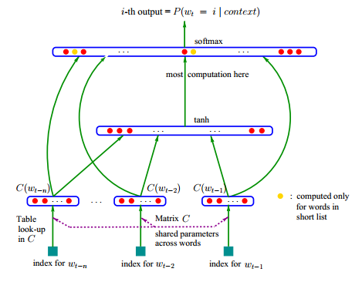
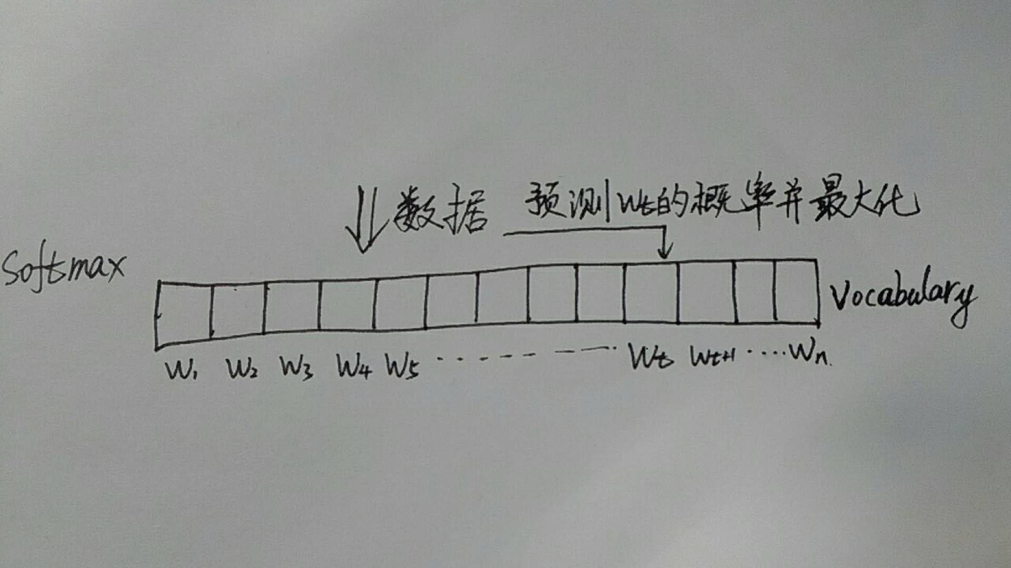
参数量过大，计算过慢
这里是否是一词多义出现的限制点？
where R(θ; C) is a regularization term (e.g. a weight decay λ||θ||2, that penalizes slightly the norm of θ)

Slide 7

------Tomas Mikolov

Slide 8


we created a test set of analogy questions of the form “a is to b as c is to _”
(1) base/comparative/superlative forms of adjectives;
(2) singular/plural forms of common nouns;
(3) possessive/non-possessive forms of common nouns;
(4) base, past and 3rd person present tense forms of verbs

Slide 9

We used the SemEval-2012 Task 2, Measuring Relation Similarity
clothing is to shirt as _______?
A. dish is to bowl
B. girl is to boy
C. man is to woman
For example, take the ClassInclusion:Singular Collective relation with the prototypical word pair clothing:shirt. To measure the degree that a target word pair dish:bowl has the same relation, we form the analogy “clothing is to shirt as dish is to bowl”

Slide 10
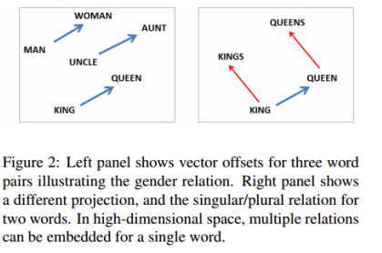
contribution:

Slide 11
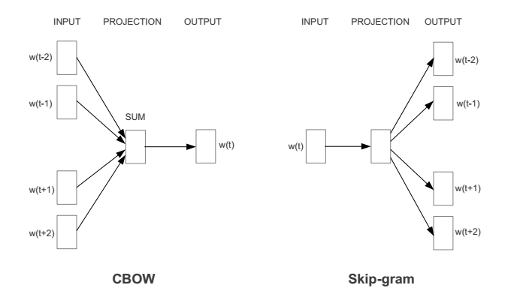
Efficient Estimation of Word Representations in Vector Space
-------Tomas Mikolov

Slide 12


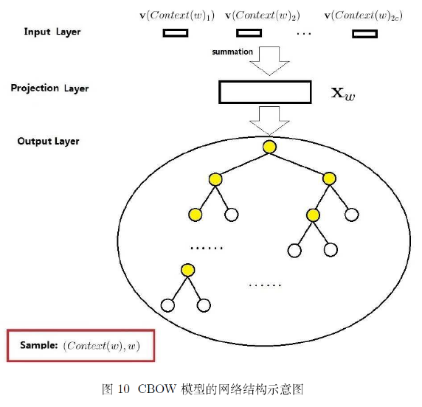
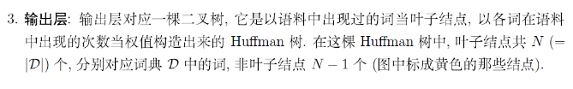
这里是否是一词多义出现的限制点？

Slide 13
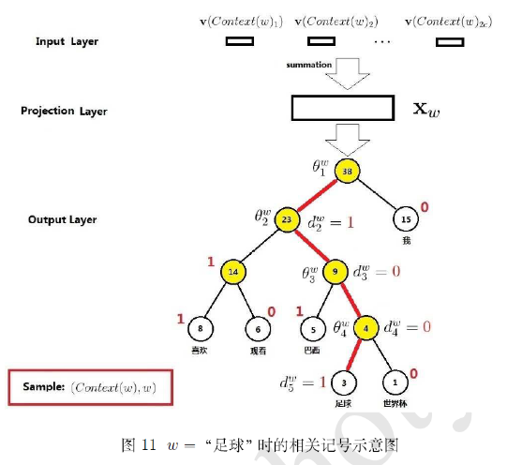




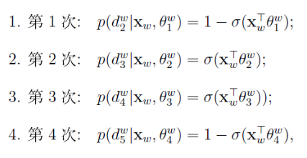


Slide 14
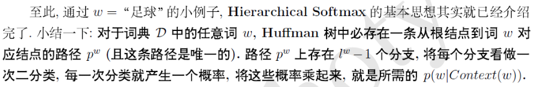
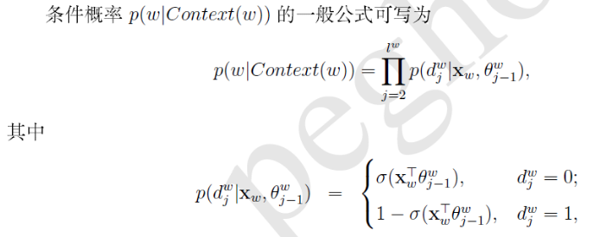
为什么可以不用归一化？

Slide 15
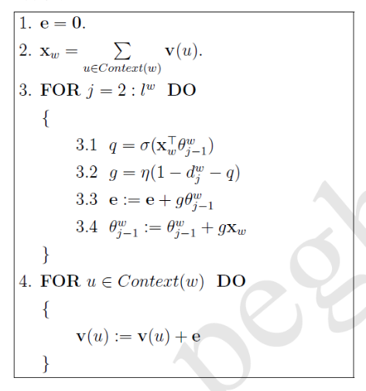
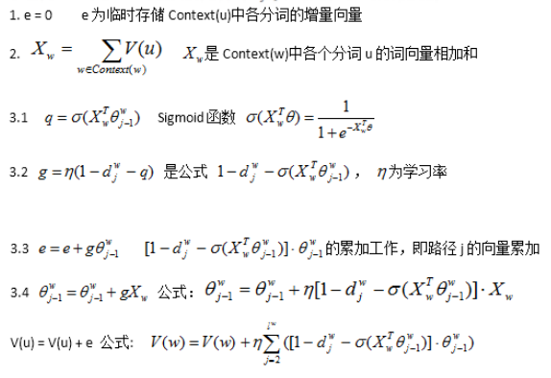
损失函数:

Slide 16

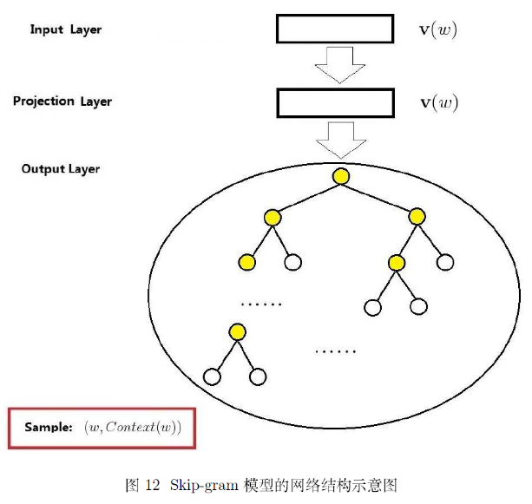
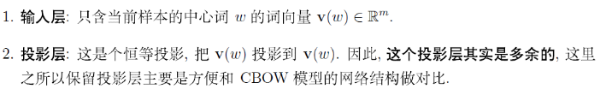


Slide 17
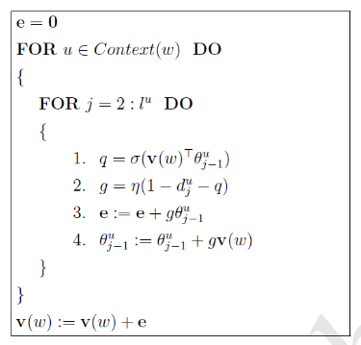
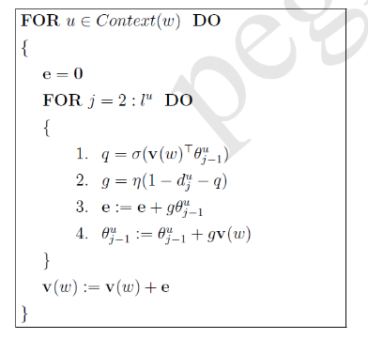

Slide 18

Negative Sampling(NEG) & Noise Contrastive Estimation(NCE)
The main difference between the Negative sampling and NCE is that NCE needs both samples and the numerical probabilities of the noise distribution, while Negative sampling(NEG) uses only samples.

Slide 19
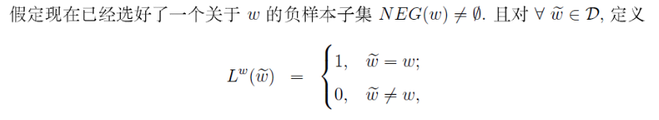

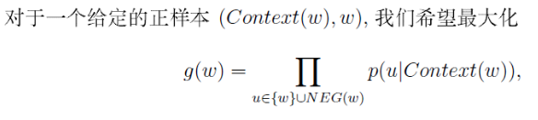
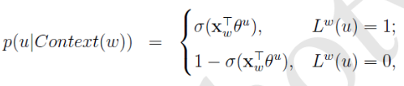

(NEG)

Slide 20
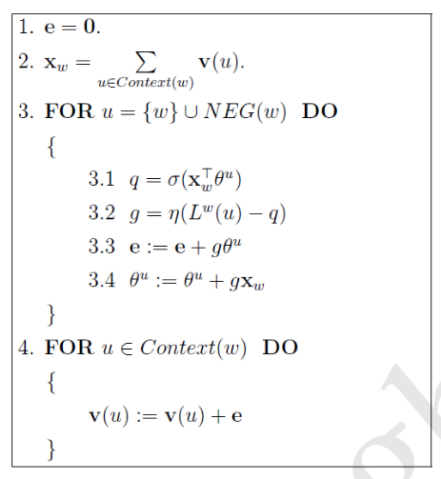
(NEG)

Slide 21

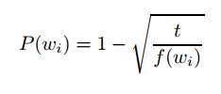
NCE

Slide 22
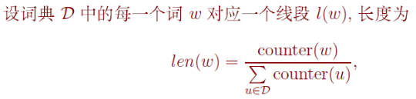
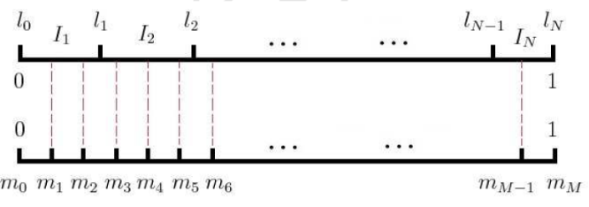

NCE

Slide 23

------Jeffrey Pennington
Matrix factorization methods for generating low dimensional word representations
eg:LSA,HAL(term-term),PCA
Another approach is to learn word representations that aid in making predictions within local context windows.
eg:CBOW,skip-gram

Slide 24


Conception:
the matrix of word-word co-occurrence counts be denoted by X
Xij tabulate the number of times word j occurs in the context of word i.
Let Xi = be the number of times any word appears in the context of word i.
let Pij = P(j|i)= Xij/Xi be the probability that word j appear in the context of word i

Slide 25
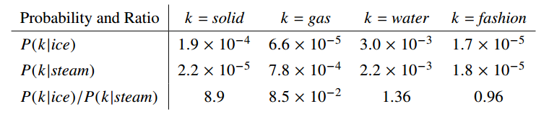

eg.(word-word co-occurence)
Table 1: Co-occurrence probabilities for target words ice and steam with selected context words from a 6
billion token corpus. Only in the ratio does noise from non-discriminative words like water and fashion
cancel out, so that large values (much greater than 1) correlate well with properties specific to ice, and
small values (much less than 1) correlate well with properties specific of steam.

Slide 26




construct function of neural language model
where Wi are word vectors
Since vector spaces are inherently linear structures, the most natural way to do this is with vector differences.
While F could be taken to be a complicated function parameterized by, e.g., a neural network,
doing so would obfuscate the linear structure we are trying to capture.

Slide 27





but it is actually ill-defined since the logarithm diverges whenever its argument is zero.
A main drawback to this model is that it weighs all co-occurrences equally, even those that happen rarely or never.
are equivalent and differ only as a result of their random initializations

Slide 28
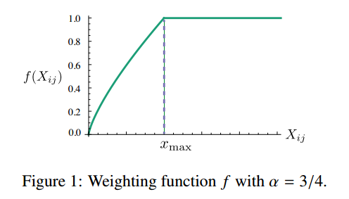




Slide 29
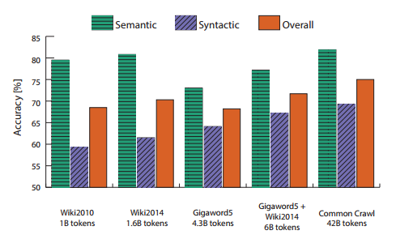
Figure 3: Accuracy on the analogy task for 300-dimensional vectors trained on different corpora.

Slide 30
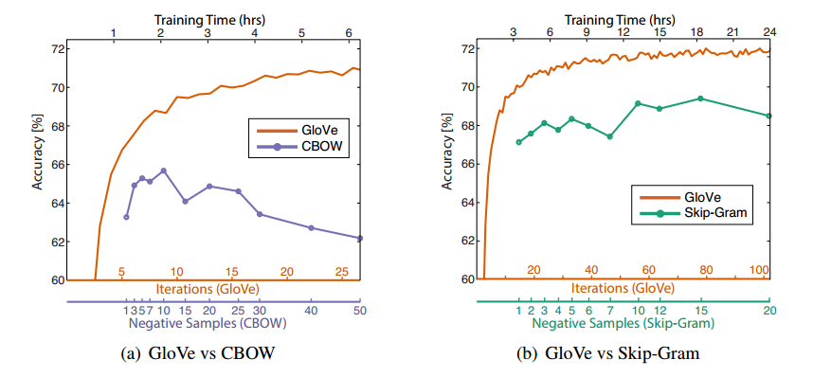
Figure 4: Overall accuracy on the word analogy task as a function of training time, which is governed by
the number of iterations for GloVe and by the number of negative samples for CBOW (a) and skip-gram
(b). In all cases, we train 300-dimensional vectors on the same 6B token corpus (Wikipedia 2014 +
Gigaword 5) with the same 400,000 word vocabulary, and use a symmetric context window of size 10.

Slide 31
A Unified Architecture for Natural Language Processing: Deep Neural Networks with Multitask Learning
------Ronan Collobert
flaws of others:
(i) they are shallow in the sense that the classifier is often linear
(ii) for good performance with a linear classifier they must incorporate many handengineered features specific for the task;
(iii) they cascade features learnt separately from other tasks,
thus propagating errors.

Slide 32
multi-tasks:
1 Part-Of-Speech Tagging (POS) aims at labeling each word with a unique tag that indicates its syntactic role, e.g. plural noun, adverb, . . .
2 Chunking, also called shallow parsing, aims at labeling segments of a sentence with syntactic constituents such as noun or verb phrase (NP or VP). Each word is assigned only one unique tag, often encoded as a begin-chunk (e.g. B-NP) or inside-chunk tag (e.g. INP).
3 Named Entity Recognition (NER) labels atomic elements in the sentence into categories such as “PERSON”, “COMPANY”, or “LOCATION”.
4 Semantic Role Labeling (SRL) aims at giving a semantic role to a syntactic constituent of a sentence.
eg. [John]ARG0 [ate]REL [the apple]ARG1
5 Language Models A language model traditionally estimates the probability of the next word being w in a sequence.We consider a different setting: predict whether the given sequence exists in nature.
6 Semantically Related Words (“Synonyms”) This is the task of predicting whether two words are semantically related (synonyms, holonyms, hypernyms...)

Slide 33

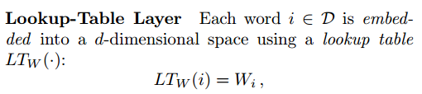
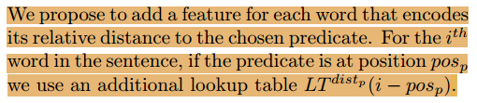
When a word is decomposed into K elements (features), it can be represented as a tuple i =
{i1, i2, . . . iK} ∈ D1 × · · · × DK
In a complex task like SRL, the class label of each word in a sentence depends on a given predicate.

Slide 34

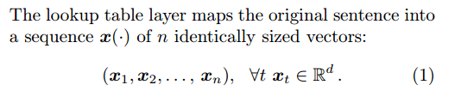
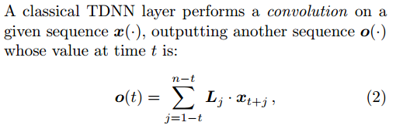
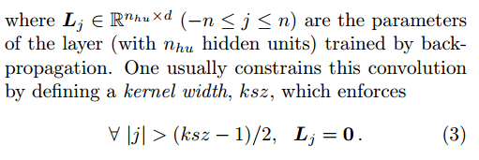
TDNN
at time t ≥ 1, one sees xt, the tth word in the sentence.

Slide 35
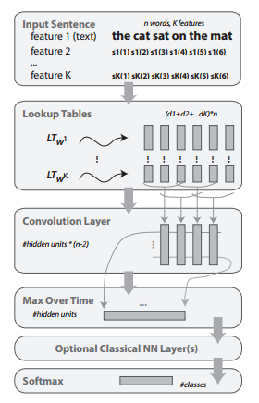
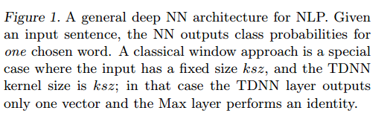

Slide 36
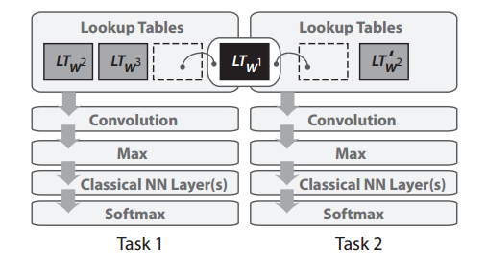
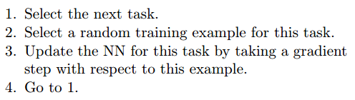
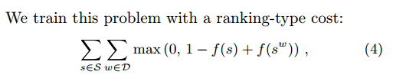
No Cascading Features
Figure 2. Example of deep multitasking with NN. Task 1
and Task 2 are two tasks trained with the architecture
presented in Figure 1. One lookup-table (in black) is shared
(the other lookup-tables and layers are task specific). The
principle is the same with more than two tasks.
Shallow Joint Training(need data labled all the features at the same time)
Leveraging Unlabeled Data

Slide 37
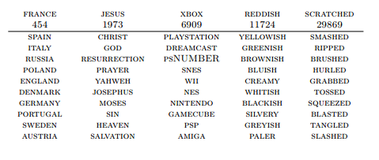
Table 1. Language model performance for learning an embedding in wsz = 50 dimensions (dictionary size: 30, 000). For each column the queried word is followed by its index in the dictionary (higher means more rare) and its 10 nearest neighbors (arbitrary using the Euclidean metric).

Slide 38
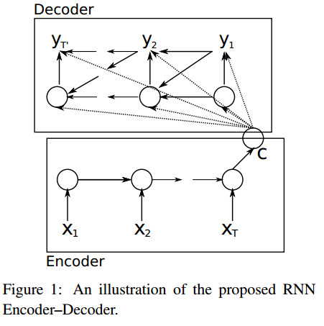




Learning Phrase Representations using RNN Encoder–Decoder for Statistical Machine Translation
-------Kyunghyun Cho

Slide 39


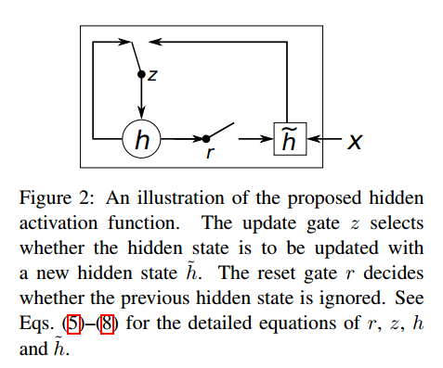
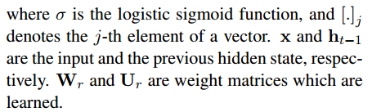




Slide 40

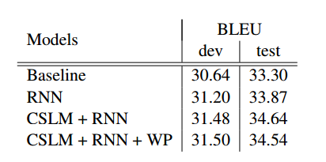
Table 1: BLEU scores computed on the development and test sets using different combinations of approaches. WP denotes a word penalty, where we penalizes the number of unknown words to neural networks.

Slide 41
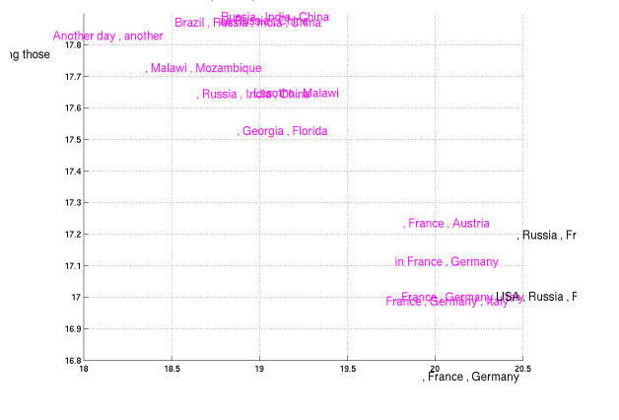
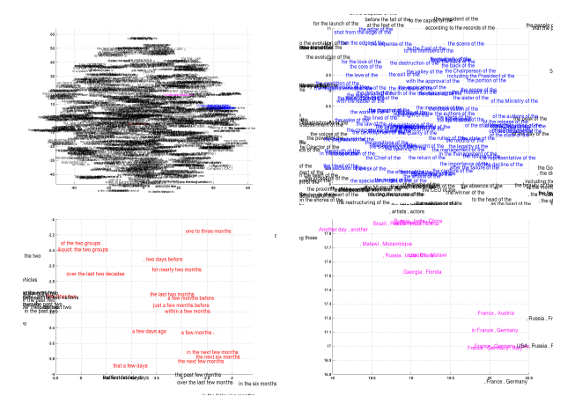
Figure 5: 2–D embedding of the learned phrase representation. The top left one shows the full representation space (5000 randomly selected points), while the other three figures show the zoomed-in view of specific regions (color–coded).

Slide 42
Conclusion
1.文本表达与统计模型的关系
2.基于softmax的改进
3.基于NCE的改进
4.基于网络结构的改进(隐藏层用RNN)
5.基于多任务的学习促进
Question
6.短语的表达？
7.句子的表达？
8.文章的表达？
9.其他方式促进文本表达问题？
10.单词二义性的解决？

Slide 43
Thanks !

